Slide 1
KANM SHOW SCHEDULING

Slide 2
Team Members
Ali Nablan
Ankit Mohanty
Davis Beilue
James Nojek
Kriti Sarker
Neeraj Julian Joseph Rajkumar
Toan Vu
Haridher Pandiyan

Slide 3

MEET Santa! It’s Christmas!
Santa is Back and Busy
Loaded with gift requests from parents to surprise their kids

Slide 4

OverwhelmeD Santa
Santa receives so many requests,
he starts missing a few!

Slide 5
Even Santa, with all his magic, couldn’t manage such an overwhelming load, leaving some kids heartbroken on Christmas morning.

Slide 6
KANM RADIO
Every semester, hundreds of students apply to be RJs, flooding the radio team with an overwhelming number of requests.

Slide 7
What do we Have? What do we get?
Our weekly schedule consists of 168 slots (24×7), but the number of incoming student requests far exceeds this, requiring careful planning to create an efficient schedule

Slide 8

Radio Team
Manual Scheduling

Slide 9
What Happens?
Overwhelming RequeSts
Scheduling chaos
Errors and confusion arise from manual scheduling.
Some students miss their preferred slots, causing disappointment.

Slide 10
What can be done?
Current Method
ADD more man power?
Manpower Efficiency
Manual method is error-prone and inefficient
You could add 10 people to help, but is this efficient?
Why waste human resources on repetitive tasks?

Slide 11
What can be done?
Enjoy manual work
What About TIME?
The Game-Changer
Some people might enjoy doing such manual work
Time is more valuable than money is an arguable point!
Our application automates scheduling and hence saves time.

Slide 12

What does our application DO?
We receive inputs from hundreds of students
We process them efficiently
And we generate a 24*7 weekly schedule!

Slide 13

Final output
A 24*7 Weekly Calendar schedule

Slide 14

Making Everyone Happy!
Our scheduling solution brings joy to the KANM radio team, streamlining their work and making their lives easier. And who knows? Maybe Santa can borrow a tip or two to make Christmas even merrier!"

Slide 15
What’s Next?
"We’ve explored the purpose and importance of this project."
WHAT ? Why?
How?
We’ve explored the purpose and importance of this project.
Now, let’s dive into how we’re brought this project to life through our design and development through the sprints.

Slide 16
PROJECT REQUIREMENTS
COURSE REQUIREMENTS
CLIENT REQUIREMENTS
Develop using Ruby on Rails.
Test using Cucumber and RSpec with 90% coverage, code quality of B+.
Use Google OAuth for logins.
Deploy on Heroku.
4 Sprints of 2 weeks each.
Prepare Design Documents.
Generate a fairly populated schedule.
Prioritize RJs based on key attributes.
Work with spreadsheets generated by Google form responses.
Provide the Final Schedule and Unassigned RJ list.
Controlled Access.

Slide 17

Chief system components
"We’ve explored the purpose and importance of this project."
Login with Google OAuth
Spreadsheet Management
User Management
Scheduling Algorithm
Calendar View

Slide 18
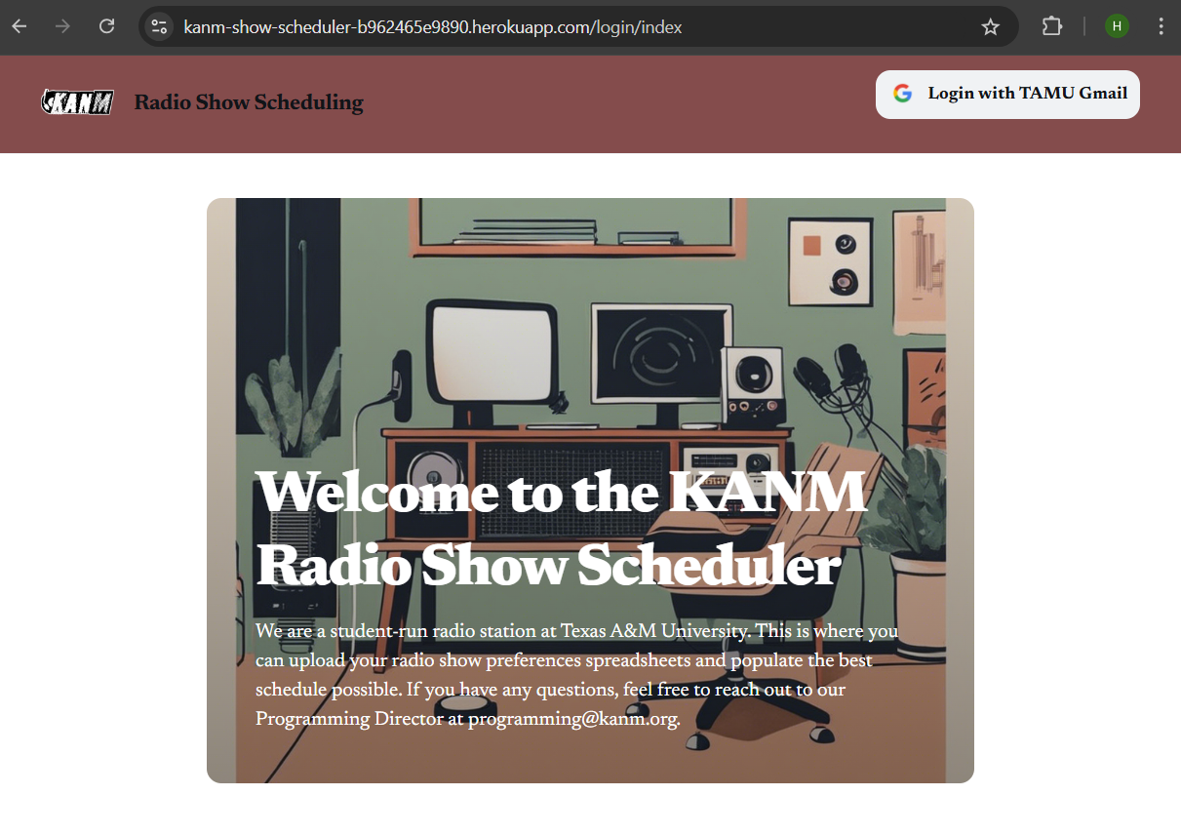
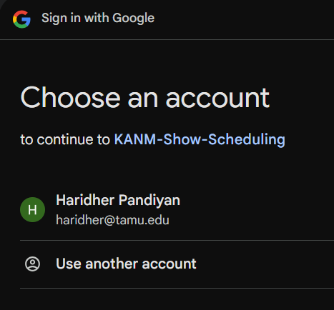
Login with google oauth
"We’ve explored the purpose and importance of this project."
Only “@tamu.edu” emails are allowed to Login.
Requires the creation of a GCP Project and addition of Callback endpoint.
Only Admins are allowed to Login.
These will be members of the KANM Team.
Added either by the Superuser Admin or seeded into the Database.

Slide 19
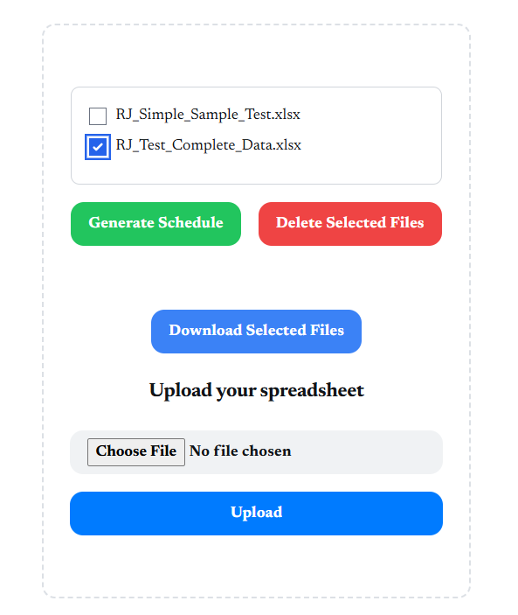
SPREADSHEET MANAGEMENT
"We’ve explored the purpose and importance of this project."
Upload the required spreadsheets.
Once uploaded, the spreadsheets will appear at the top with checkboxes for selection.
Select multiple spreadsheets for Download or to Delete.
Select a single spreadsheet to Generate Schedule.
We expect the spreadsheets to have 2 sheets, one for Returning RJs and other for New RJs.

Slide 20
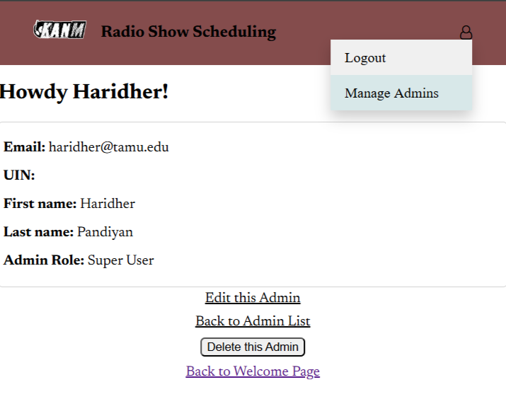
USER MANAGEMENT
"We’ve explored the purpose and importance of this project."
We refer to the website users as Admins.
CRUD operations for Admins are available only to the Super-user Admin.
The relevant pages can be accessed from the drop down menu from hovering over the Profile icon, only visible to super-user admin.
Thus super-users can safely control which new members of the KANM to get access to this Scheduler application.

Slide 21
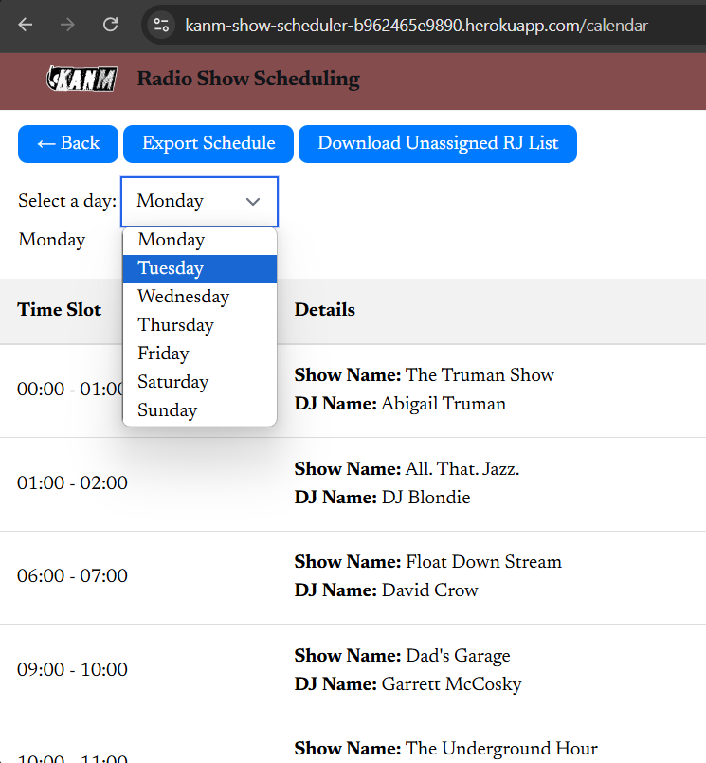
CALENDAR VIEW
"We’ve explored the purpose and importance of this project."
Once the schedule has been processed, it gets displayed in the calendar page.
Only the assigned time-slots with the respective show names and linked DJs are displayed.
Dropdown to select a specific day.
Export options for the full schedule as well as the unassigned RJs.

Slide 22

SCHEDULING ALGORITHM
"We’ve explored the purpose and importance of this project."
Retained Slots: Retain previous slots for returning RJs who opted to keep them.
Sort RJs: Prioritize returning RJs, then new RJs. Then sort by semesters in KANM, graduation date, and timestamp.
With this ordered list, begin to Assign Slots:
Attempt to assign preferred slots first.
Use Radial Search for alternative slots if preferred ones are unavailable.
Handle Unassigned RJs: Add RJs to an unassigned list if no slots are available.

Slide 23

RADIAL SEARCH
"We’ve explored the purpose and importance of this project."
Radial Search Outer Loop: Start with a radius of 3 hours, incrementing the search band by 3 until 12.
Inner Loop of Days, starting from Best Day.
Range Calculation: Identify alternative slots within current band range.
Day Boundary Handling: Account for previous and next day overflow.
Slot Selection: Choose middle entry of range as closest match.
Availability Check: Assign if available, else continue search.
Unassigned Handling: Mark DJ as unassigned if no slot found.

Slide 24

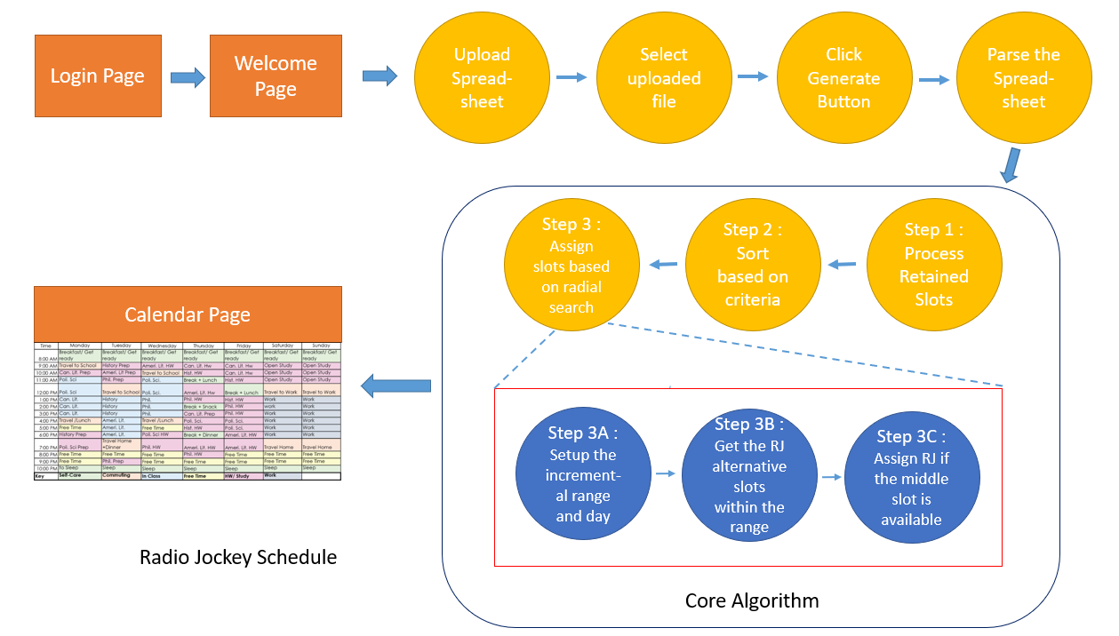
APPLICATION WORKFLOW
"We’ve explored the purpose and importance of this project."

Slide 25

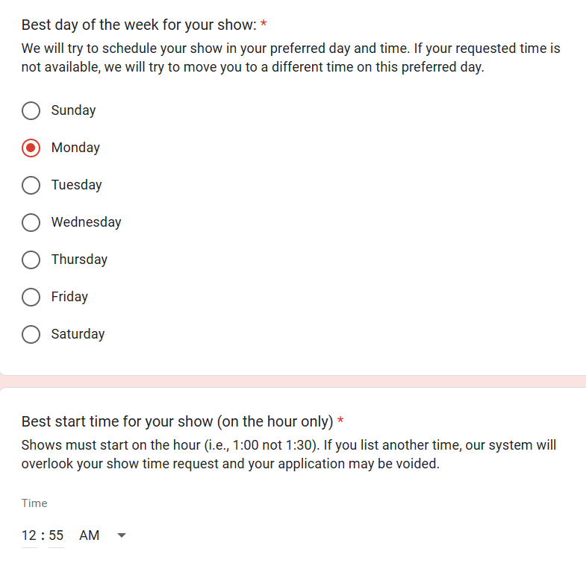
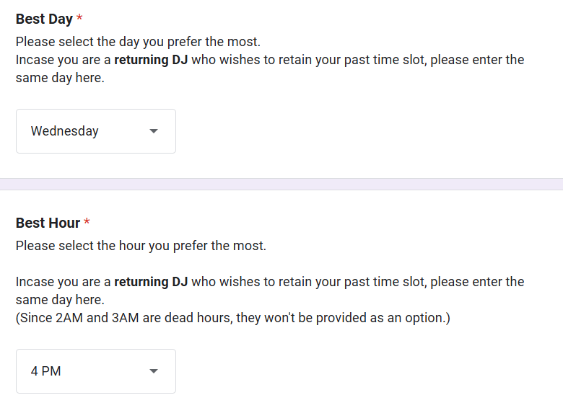
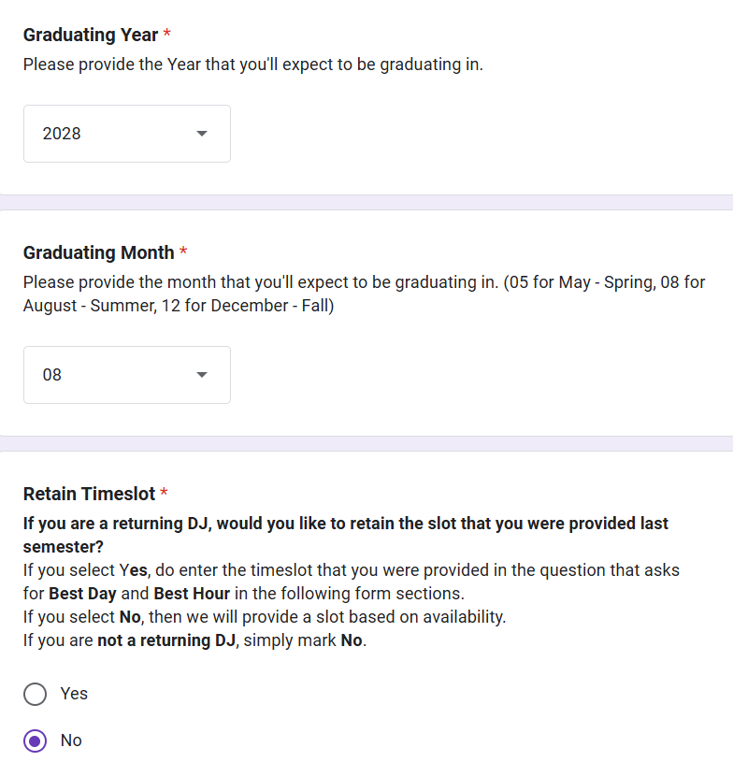
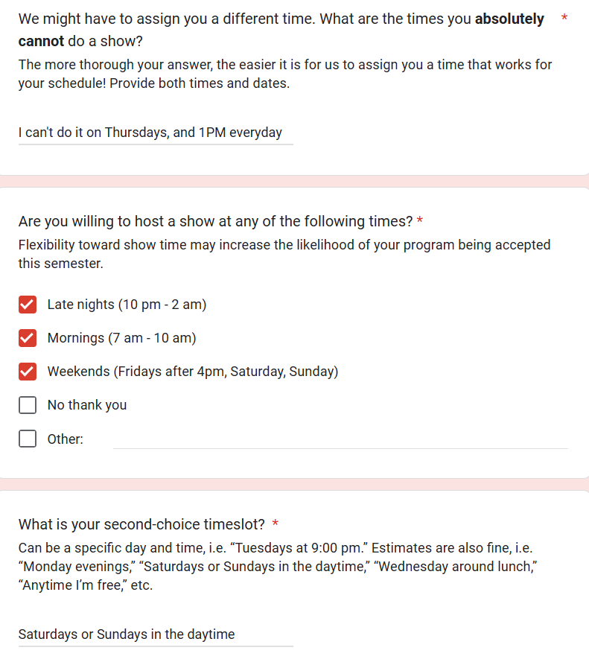
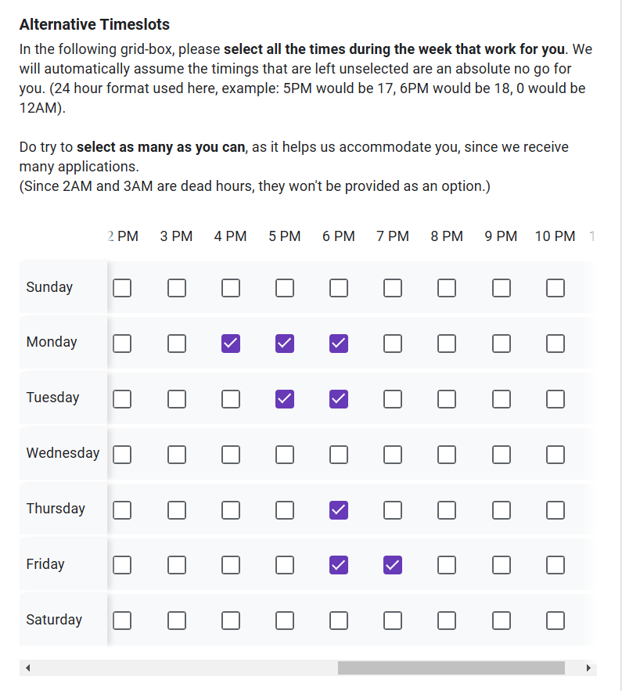
Requested GOOGLE FORM changes
"We’ve explored the purpose and importance of this project."
Former text form fields resulted in a hodgepodge of responses.
Hard to understand and easy to misinterpret.
New form fields are direct and extract clear data.
OLD
NEW

Slide 26

Project timeline
SPRINT 1
SPRINT 2
SPRINT 3
SPRINT 4
"We’ve explored the purpose and importance of this project."
Initial Project Setup, local and deployment on Heroku.
Login Feature with Google OAuth.
Spreadsheet Management : Upload, Download, View and Deletion.
User(admins) management via Super-User.
Implementation of the Scheduling Algorithm.
Basic version of the Calendar view.
Finalized Calendar view.
Improved scheduling algorithm.
Resolving any pending bugs.

Slide 27

Project impact
"We’ve explored the purpose and importance of this project."
Automation: Automated assignment of 168 weekly slots, significantly reducing the manual effort and time spent on this task.
Improved Fairness and Compliance: Implemented priority-based sorting for RJ assignments, ensuring equitable slot distribution.
Enhanced User Experience: Provided a user-friendly interface for admins to manage schedules and for RJs to view their assigned slots.
Increased Efficiency: Optimized resource allocation by matching RJs to available slots based on preferences and priorities.

Slide 28

FUTURE SCOPE
"We’ve explored the purpose and importance of this project."
Further refine the scheduling algorithm.
Improve code quality.
Add additional tests and reach nearly 100% coverage.
Generating Schedules for every week by accounting into the Unavailable Dates fields.
Data Analysis, identifying peak hours and days, and other valuable insights.

Slide 29

ONTO THE DEMO!

